Slide 1
Cluster algebras and Poisson geometry
Dmitriy Voloshyn
Institute for Basic Science
Center for Geometry and Physics

Slide 2


Plan of the talk
Part 1. Cluster algebras (by example)
The main concepts of the cluster theory via an example on $GL_{3}$.
Part 2. Cluster algebras and Poisson geometry
Compatibility between a cluster structure and a Poisson bracket; how to construct a cluster structure via Poisson geometry.
Part 3. Research program
Belavin-Drinfeld data; the three main objects of the GSV program; construction of a Poisson birational quasi-isomorphism for $𝒢𝒞(Γ^{r},Γ^{c})$; an explicit example in $GL_{3}$.
Part 4. Description of $𝒢𝒞^{\text{†}}(Γ)$ in type $A$
The main features of the construction and the results of the paper arXiv:2312.04859.
Part 5. Features of $𝒢𝒞^{\text{D}}(Γ^{r},Γ^{c})$ in type $A$
The relation between $𝒢𝒞\left(Γ^{r},Γ^{c}\right)$, $𝒢𝒞^{D}(Γ^{r},Γ^{c})$ and $𝒢𝒞^{\text{†}}(Γ^{r},Γ^{c})$.
Part 6. Status of the program

Slide 3





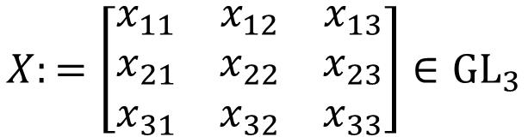











Part 1. Cluster algebras (by example)
$$\left|\begin{matrix}x_{12} & x_{13} \\ x_{22} & x_{23}\end{matrix}\right|$$
$$X:=\left[\begin{matrix}x_{11} & x_{12} & x_{13} \\ x_{21} & x_{22} & x_{23} \\ x_{31} & x_{32} & x_{33}\end{matrix}\right]∈GL_{3}$$
$$\det{X}$$
$$x_{13}$$
$$\left|\begin{matrix}x_{21} & x_{22} \\ x_{31} & x_{32}\end{matrix}\right|$$
The functions visualized:
$$x_{23}$$
$$\left|\begin{matrix}x_{22} & x_{23} \\ x_{32} & x_{33}\end{matrix}\right|$$
$$\begin{matrix}⋅ & ⋅ & ⋅ \\ ⋅ & ⋅ & ⋅ \\ ⋅ & ⋅ & ⋅\end{matrix}$$
$$\begin{matrix}⋅ & ⋅ & ⋅ \\ ⋅ & ⋅ & ⋅ \\ ⋅ & ⋅ & ⋅\end{matrix}$$
$$\begin{matrix}⋅ & ⋅ & ⋅ \\ ⋅ & ⋅ & ⋅ \\ ⋅ & ⋅ & ⋅\end{matrix}$$
$$x_{31}$$
$$x_{32}$$
$$x_{33}$$
$$1×1$$
$$2×2$$
$$3×3$$
(det is dropped for convenience)
(pick either the last columns or the last rows)
The (initial) extended seed:
(initial) quiver
frozen vertex
(the attached function is a frozen variable)
$$Σ≔(x,Q)$$
(initial) extended cluster
mutable vertex
(the attached function is a cluster variable)
(that is, the initial collection of functions)

Slide 4
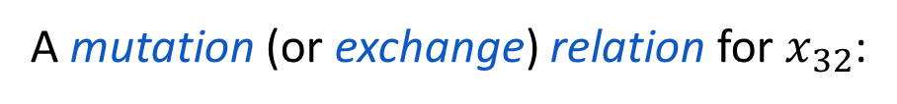







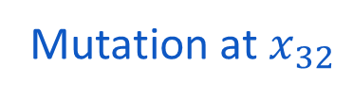



Mutation (by example)
A mutation is an involutive operation on (extended) seeds:
Replaces a chosen cluster variable with a new one;
Updates the quiver.
$$\left|\begin{matrix}x_{12} & x_{13} \\ x_{22} & x_{23}\end{matrix}\right|$$
$$\left|\begin{matrix}x_{12} & x_{13} \\ x_{22} & x_{23}\end{matrix}\right|$$
$$\det{X}$$
$$x_{13}$$
$$\det{X}$$
$$x_{13}$$
Mutation at $x_{32}$
$$\left|\begin{matrix}x_{21} & x_{22} \\ x_{31} & x_{32}\end{matrix}\right|$$
$$\left|\begin{matrix}x_{21} & x_{22} \\ x_{31} & x_{32}\end{matrix}\right|$$
$$x_{23}$$
$$x_{23}$$
$$\left|\begin{matrix}x_{22} & x_{23} \\ x_{32} & x_{33}\end{matrix}\right|$$
$$\left|\begin{matrix}x_{22} & x_{23} \\ x_{32} & x_{33}\end{matrix}\right|$$
$$x_{31}$$
$$x_{32}$$
$$x_{33}$$
$$x_{31}$$
$$\left|\begin{matrix}x_{21} & x_{23} \\ x_{31} & x_{33}\end{matrix}\right|$$
$$x_{33}$$
A mutation (or exchange) relation for $x_{32}$:
$$x_{32}⋅\det\left[\begin{matrix}x_{21} & x_{23} \\ x_{31} & x_{33}\end{matrix}\right]=\det\left[\begin{matrix}x_{22} & x_{23} \\ x_{32} & x_{33}\end{matrix}\right]x_{31}+\det\left[\begin{matrix}x_{21} & x_{22} \\ x_{31} & x_{32}\end{matrix}\right]x_{33}$$
A new cluster variable that replaces $x_{32}$

Slide 5
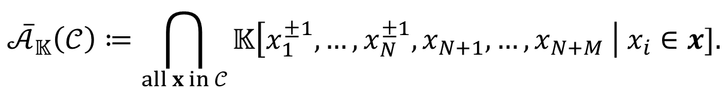
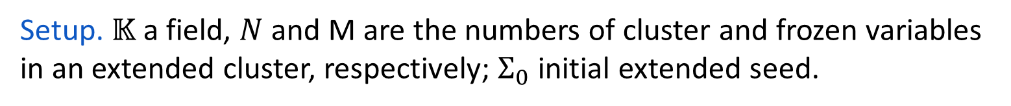
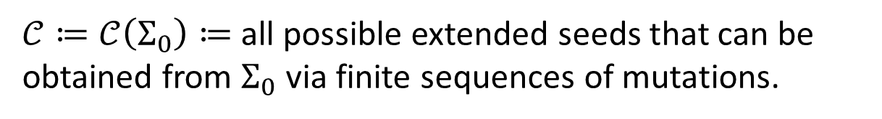

Main definitions
Setup. $𝕂$ a field, $N$ and M are the numbers of cluster and frozen variables in an extended cluster, respectively; $Σ_{0}$ initial extended seed.
Cluster structure
$𝒞≔𝒞\left(Σ_{0}\right)≔$ all possible extended seeds that can be obtained from $Σ_{0}$ via finite sequences of mutations.
Cluster algebra
$$𝒜_{𝕂}\left(𝒞\right)≔𝕂\left[ \text{all} \text{cluster} \text{and} \text{frozen} \text{variables} \text{from} 𝒞\right].$$
(these vary in the intersection)
cluster variables
$${\overline{𝒜}}_{𝕂}\left(𝒞\right)≔\bigcap_{all x in 𝒞}{𝕂\left[x_{1}^{±1},…,x_{N}^{±1},x_{N+1},…,x_{N+M} \right| x_{i}∈x].}$$
Upper cluster algebra
frozen variables
(these don’t change)
Theorem (Laurent Phenomenon).
$$𝒜_{𝕂}\left(𝒞\right)⊆{\overline{𝒜}}_{𝕂}\left(𝒞\right).$$

Slide 6



Program on cluster algebras
(S. Fomin, A. Zelevinsky, 2001)
For every interesting variety $V$ over a field $𝕂$ in Lie theory, find $𝒞$ such that
$$𝒪\left(V\right)=𝒜_{𝕂}\left(𝒞\right)$$
coordinate ring of $V$
Example.
$$𝒪\left(GL_{3}\right)=𝒜_{𝕂}\left(𝒞\right).$$
However, usually we are only able to show $𝒪\left(V\right)={\overline{𝒜}}_{𝕂}(𝒞)$.
(for instance, for cluster structures on double Bruhat cells $G^{u,v}$, although we know that $𝒪\left(G^{u,v}\right)={\overline{𝒜}}_{𝕂}\left(𝒞\right)$, we still do not know whether $𝒪\left(G^{u,v}\right)=𝒜_{𝕂}(𝒞)$ )
Question. How to construct a cluster structure in the first place?
Notes:
First lecture (1 hour) ended on this slide.

Slide 7


Part 2. Cluster algebras and Poisson geometry
Setup. $𝒜≔$ a commutative algebra over a field $𝕂$.
Def. A Poisson bracket $\left\{ , \right\}:𝒜×𝒜→𝒜$ is a skew-symmetric bilinear form that satisfies the Jacobi identity and the Leibniz rule in each slot.
Jacobi identity:
$$\left\{a,\left\{b,c\right\}\right\}+\left\{b,\left\{c,a\right\}\right\}+\left\{c,\left\{a,b\right\}\right\}=0$$
$$∀a,b,c∈𝒜$$
Leibniz rule:
$$\left\{a⋅b,c\right\}=a\left\{b,c\right\}+\left\{a,c\right\}b$$
Def. Elements $a,b∈𝒜$ are log-canonical if $\left\{a,b\right\}=ω⋅ab$, $ω∈𝕂$.
A subset $S⊆𝒜$ is log-canonical if all elements in $S$ are pairwise log-canonical.
Def. A cluster structure is compatible with a Poisson bracket if every extended cluster is log-canonical.

Slide 8

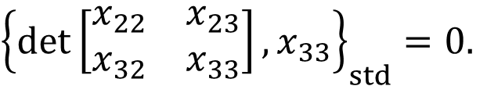
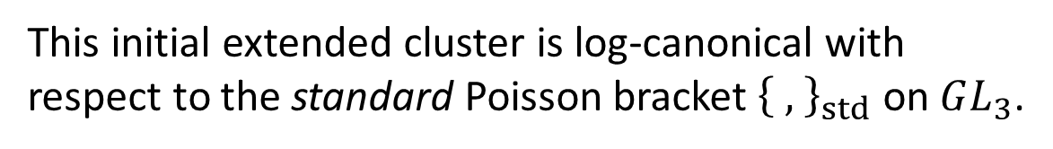
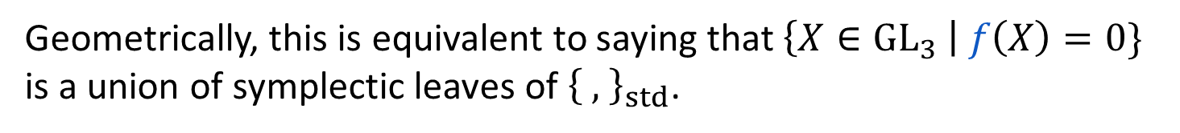
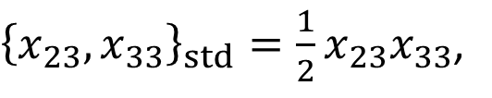
A remarkable observation
(M. Gekhtman, M. Shapiro, A. Vainshtein, 2003)
$$\left|\begin{matrix}x_{12} & x_{13} \\ x_{22} & x_{23}\end{matrix}\right|$$
This initial extended cluster is log-canonical with respect to the standard Poisson bracket ${\left\{ , \right\}}_{std}$ on $GL_{3}$.
$$\det{X}$$
$$x_{13}$$
(we explain later what standard means)
$$\left|\begin{matrix}x_{21} & x_{22} \\ x_{31} & x_{32}\end{matrix}\right|$$
For example,
$$x_{23}$$
$$\left|\begin{matrix}x_{22} & x_{23} \\ x_{32} & x_{33}\end{matrix}\right|$$
${\{x_{31},x_{32}\}}_{std}=x_{31}x_{32},$
${\left\{x_{23},x_{33}\right\}}_{std}=\frac{1}{2}x_{23}x_{33}$,
${\left\{\det\left[\begin{matrix}x_{22} & x_{23} \\ x_{32} & x_{33}\end{matrix}\right],x_{33}\right\}}_{std}=0.$
$$x_{31}$$
$$x_{32}$$
$$x_{33}$$
Even more is true:
Every extended cluster is log-canonical;
The frozen variables generate Poisson prime ideals in $𝒪(GL_{3})$:
$\left\{\left(f\right),g\right\}⊆(f)$ for any frozen $f$ and any $g∈𝒪(GL_{3})$;
Geometrically, this is equivalent to saying that $\left\{X∈GL_{3} \right| f\left(X\right)=0\}$ is a union of symplectic leaves of ${\left\{ , \right\}}_{std}$.
(B. Nguyen, K. Trampel, M. Yakimov, 2017)

Slide 9




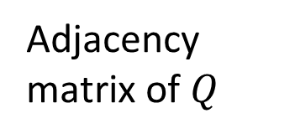

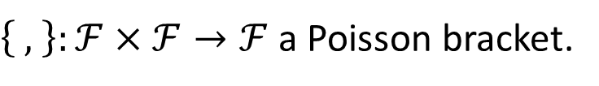



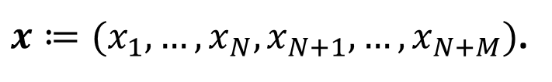
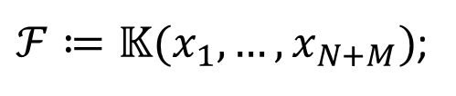


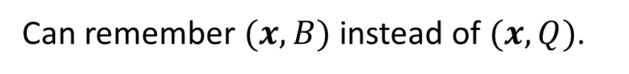
How to verify the compatibility with a Poisson bracket?
Setup. $(x,Q)$ the initial extended seed of some cluster structure,
quiver
$x≔(x_{1},…, x_{N},x_{N+1},…,x_{N+M})$.
cluster variables
frozen variables
Exchange matrix $B$:
Can remember $(x,B)$ instead of $(x,Q)$.
Adjacency matrix of $Q$
$$B$$
$$=$$
$$N$$
$ℱ≔𝕂(x_{1},…,x_{N+M})$;
$$0$$
$$M$$
$\left\{ , \right\}:ℱ×ℱ→ℱ$ a Poisson bracket.
$$N$$
$$M$$
Theorem. Assume that the mutable part of $Q$ is connected. TFAE:
i)
$B$ has full rank and the cluster structure is compatible with $\left\{ , \right\}$;
ii)
$x$ is log-canonical and
$$BΩ=\left[λI 0\right]$$
(compatibility equation)
where $λ∈𝕂^{∗}$, $Ω≔{\left(ω_{ij}\right)}_{i,j=1}^{N+M}$, $\left\{x_{i},x_{j}\right\}=ω_{ij}x_{i}x_{j}$, $ω_{ij}∈𝕂$.
(M. Gekhtman, M. Shapiro, A. Vainshtein, 2003)

Slide 10

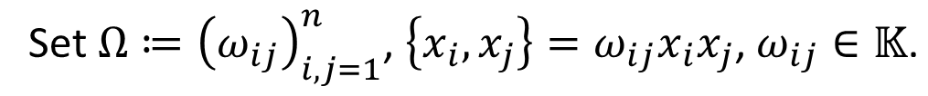



How to construct a cluster structure?
Setup. A variety $V$ over a field $𝕂$, $n≔\dim{V}$.
field of rational functions on $V$
Empirical algorithm:
Introduce a Poisson bracket $\{ , \}:𝕂\left(V\right)×𝕂\left(V\right)→𝕂\left(V\right)$;
Find a log-canonical family $x≔\left(x_{1},…,x_{n}\right), x_{i}∈𝒪\left(V\right)$;
Set $Ω≔{\left(ω_{ij}\right)}_{i,j=1}^{n}\text{, }\left\{x_{i},x_{j}\right\}=ω_{ij}x_{i}x_{j}\text{, }ω_{ij}∈𝕂\text{.}$
For frozen variables, choose those $x_{i}$ that generate Poisson prime ideals.
This also gives $n=N+M$ where $M= \#$frozen variables.
Solve the compatibility equation with respect to an $N×(N+M)$ matrix $B$:
$$BΩ=[I 0]$$
$$(∗)$$
(if $B$ has entries in $ℚ$, can multiply both sides by a common denominator)
Then $(x,B)$ is the initial extended seed for some cluster structure $C$ on $V$.
Remark. If $(∗)$ has many solutions, can introduce extra structures (e.g., a toric action). This way one extracts a unique solution.

Slide 11







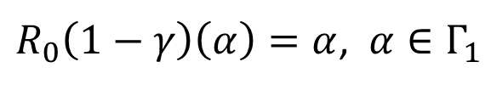
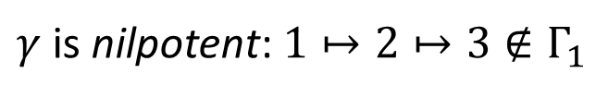



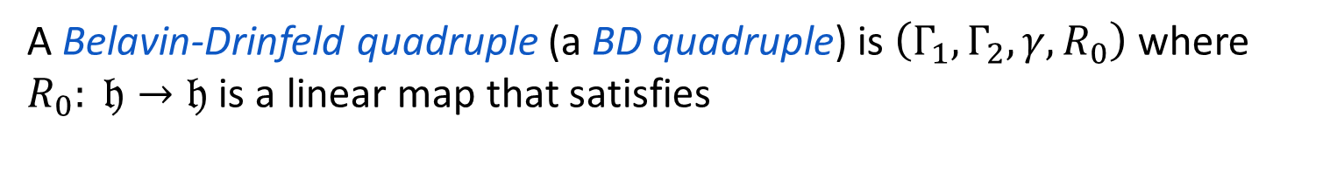
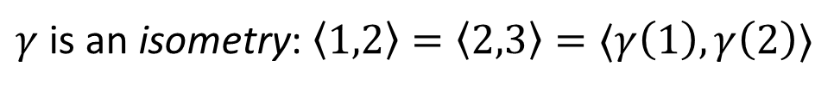

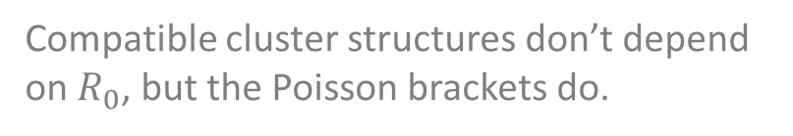
Part 3. Research program
Setup. $𝔤$ is a simple complex Lie algebra, $Π$ a set of simple roots,
$𝔥$ the Cartan subalgebra, $< , >$ symmetric invariant nondegenerate form on $𝔤$.
Def. A Belavin-Drinfeld triple (a BD triple) is $Γ≔\left(Γ_{1},Γ_{2},γ \right)$ where $Γ_{1},Γ_{2}⊂Π$
and $γ:Γ_{1}→Γ_{2}$ is a nilpotent isometry.
(that is, $∀α∈Γ_{1}∃m>0 :γ^{m}\left(α\right)∉Γ_{1}$)
A Belavin-Drinfeld quadruple (a BD quadruple) is $\left(Γ_{1},Γ_{2},γ,R_{0}\right)$ where $R_{0}: 𝔥→𝔥$ is a linear map that satisfies
$$R_{0}+R_{0}^{∗}=id$$
Compatible cluster structures don’t depend on $R_{0}$, but the Poisson brackets do.
$R_{0}\left(1−γ\right)\left(α\right)=α$, $α∈Γ_{1}$
Example. $𝔤=sl_{4}(ℂ)$, $Γ_{1}≔\{1,2\}, Γ_{2}≔\left\{2,3\right\}$, $γ\left(1\right)≔2$, $γ\left(2\right)≔3$.
$$1$$
$$2$$
$$3$$
$γ$ is an isometry: $\left\langle 1,2\right\rangle =\left\langle 2,3\right\rangle =⟨γ\left(1\right),γ\left(2\right)⟩$
$$γ$$
$$γ$$
$γ$ is nilpotent: $1↦2↦3∉Γ_{1}$
$$1$$
$$2$$
$$3$$

Slide 12
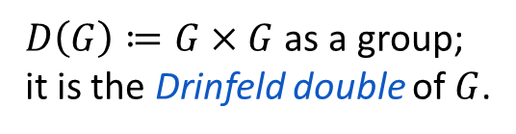


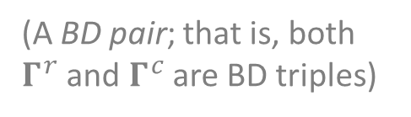
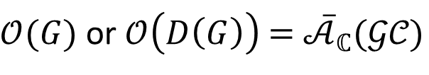
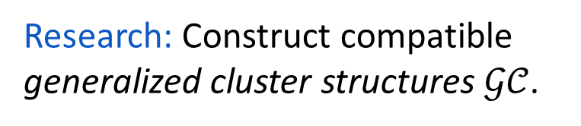

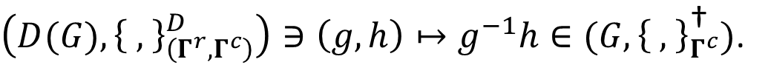


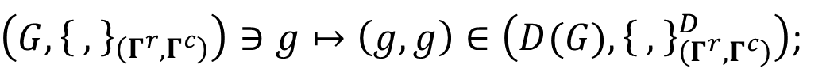

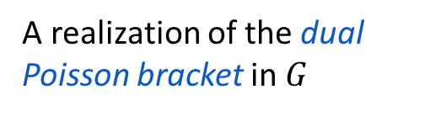

Setup. $G$ is a connected simply connected simple complex algebraic group.
(A BD pair; that is, both $Γ^{r}$ and $Γ^{c}$ are BD triples)
$$\left(G,{\left\{ , \right\}}_{\left(Γ^{r}, Γ^{c}\right)}\right)$$
$$𝒢𝒞(Γ^{r},Γ^{c})$$
the group itself
Belavin & Drinfeld classification (1982)
$$\left(D(G),{\left\{ , \right\}}_{\left(Γ^{r},Γ^{c}\right)}^{D}\right)$$
$$(Γ^{r},Γ^{c})$$
$$𝒢𝒞^{D}(Γ^{r},Γ^{c})$$
$D\left(G\right)≔G×G$ as a group;
it is the Drinfeld double of $G$.
(classification of factorizable quasi-triangular Poisson brackets)
$$\left(G,{\left\{ , \right\}}_{Γ^{c}}^{\text{†}}\right)$$
$$𝒢𝒞^{\text{†}}(Γ^{c})$$
A realization of the dual Poisson bracket in $G$
The following maps are Poisson:
Research: Construct compatible generalized cluster structures $𝒢𝒞$.
$\left(G,{\left\{ , \right\}}_{\left(Γ^{r},Γ^{c}\right)}\right)∋g↦\left(g,g\right)∈\left(D(G),{\left\{ , \right\}}_{\left(Γ^{r},Γ^{c}\right)}^{D}\right)$;
$\left(D(G),{\left\{ , \right\}}_{\left(Γ^{r},Γ^{c}\right)}^{D}\right)∋\left(g,h\right)↦g^{−1}h∈(G,{\left\{ , \right\}}_{Γ^{c}}^{\text{†}})$.
We also require:
(at least they show relations between the three objects)
$𝒪(G)$ or $𝒪\left(D\left(G\right)\right)$ $=$ ${\overline{𝒜}}_{ℂ}(𝒢𝒞)$
(Initiated by M. Gekhtman, M. Shapiro and A. Vainshtein in 2010)

Slide 13
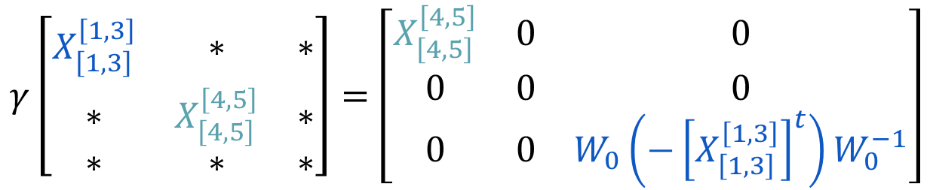




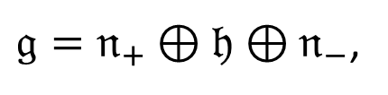




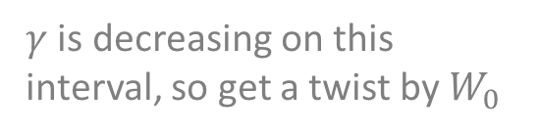






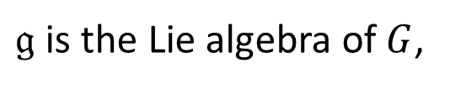


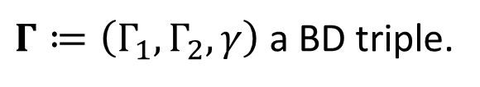
Sidenote: An extension of $γ:Γ_{1}→Γ_{2}$
Setup. $G$ is a connected simply connected simple complex algebraic group,
$𝔤$ is the Lie algebra of $G$,
$𝔤=𝔫_{+}⊕𝔥⊕𝔫_{−}$,
$𝒩_{±}$, $ℋ$ connected subgroups of $G$ that correspond to $𝔫_{±}$ and $𝔥$,
$Γ≔\left(Γ_{1},Γ_{2},γ\right)$ a BD triple.
$γ:Γ_{1}→Γ_{2}$ can be extended to a linear map $γ:𝔤→𝔤$
(a precise construction is in the papers)
The restrictions $γ{\left.​\right|}_{𝔫_{±}}:𝔫_{±}→𝔫_{±}$ are Lie algebra homomorphisms
(the same for $γ^{∗}:Γ_{2}→Γ_{1})$
Get Lie group homomorphisms $\tilde{γ}:𝒩_{±}→𝒩_{±}$
Example. $𝔤=gl_{6}(ℂ)$, $Γ$ as on the graph.
$$γ\left[\begin{matrix}X_{\left[1,3\right]}^{\left[1,3\right]} & ∗ & ∗ \\ ∗ & X_{\left[4,5\right]}^{\left[4,5\right]} & ∗ \\ ∗ & ∗ & ∗\end{matrix}\right]=\left[\begin{matrix}X_{\left[4,5\right]}^{\left[4,5\right]} & 0 & 0 \\ 0 & 0 & 0 \\ 0 & 0 & W_{0}\left(−{\left[X_{\left[1,3\right]}^{\left[1,3\right]}\right]}^{t}\right)W_{0}^{−1}\end{matrix}\right]$$
$$1$$
$$2$$
$$3$$
$$4$$
$$5$$
$$1$$
$$2$$
$$3$$
$$4$$
$$5$$
$γ$ is decreasing on this interval, so get a twist by $W_{0}$
$$(X∈gl_{6}\left(ℂ\right))$$
Longest Weyl group element

Slide 14
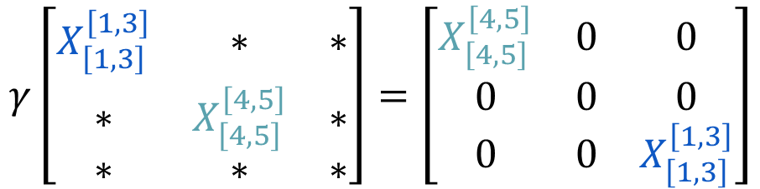
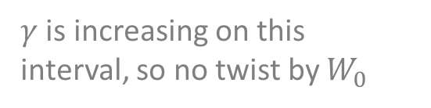
Sidenote: An extension of $γ:Γ_{1}→Γ_{2}$
Setup. $G$ is a connected simply connected simple complex algebraic group,
$𝔤$ is the Lie algebra of $G$,
$𝔤=𝔫_{+}⊕𝔥⊕𝔫_{−}$,
$𝒩_{±}$, $ℋ$ connected subgroups of $G$ that correspond to $𝔫_{±}$ and $𝔥$,
$Γ≔\left(Γ_{1},Γ_{2},γ\right)$ a BD triple.
$γ:Γ_{1}→Γ_{2}$ can be extended to a linear map $γ:𝔤→𝔤$
(a precise construction is in the papers)
The restrictions $γ{\left.​\right|}_{𝔫_{±}}:𝔫_{±}→𝔫_{±}$ are Lie algebra homomorphisms
(the same for $γ^{∗}:Γ_{2}→Γ_{1})$
Get Lie group homomorphisms $\tilde{γ}:𝒩_{±}→𝒩_{±}$
Example. $𝔤=gl_{6}(ℂ)$, $Γ$ as on the graph.
$$γ\left[\begin{matrix}X_{\left[1,3\right]}^{\left[1,3\right]} & ∗ & ∗ \\ ∗ & X_{\left[4,5\right]}^{\left[4,5\right]} & ∗ \\ ∗ & ∗ & ∗\end{matrix}\right]=\left[\begin{matrix}X_{\left[4,5\right]}^{\left[4,5\right]} & 0 & 0 \\ 0 & 0 & 0 \\ 0 & 0 & X_{\left[1,3\right]}^{\left[1,3\right]}\end{matrix}\right]$$
$$1$$
$$2$$
$$3$$
$$4$$
$$5$$
$$1$$
$$2$$
$$3$$
$$4$$
$$5$$
$γ$ is increasing on this interval, so no twist by $W_{0}$
$$(X∈gl_{6}\left(ℂ\right))$$

Slide 15
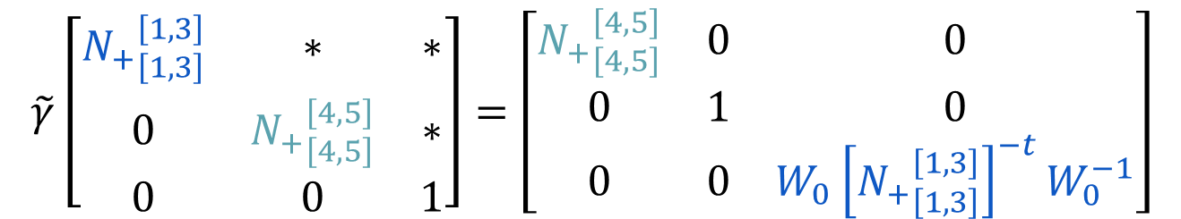

Sidenote: An extension of $γ:Γ_{1}→Γ_{2}$
Setup. $G$ is a connected simply connected simple complex algebraic group,
$𝔤$ is the Lie algebra of $G$,
$𝔤=𝔫_{+}⊕𝔥⊕𝔫_{−}$,
$𝒩_{±}$, $ℋ$ connected subgroups of $G$ that correspond to $𝔫_{±}$ and $𝔥$,
$Γ≔\left(Γ_{1},Γ_{2},γ\right)$ a BD triple.
$γ:Γ_{1}→Γ_{2}$ can be extended to a linear map $γ:𝔤→𝔤$
(a precise construction is in the papers)
The restrictions $γ{\left.​\right|}_{𝔫_{±}}:𝔫_{±}→𝔫_{±}$ are Lie algebra homomorphisms
(the same for $γ^{∗}:Γ_{2}→Γ_{1})$
Get Lie group homomorphisms $\tilde{γ}:𝒩_{±}→𝒩_{±}$
Example. $𝔤=gl_{6}(ℂ)$, $Γ$ as on the graph.
$$\tilde{γ}\left[\begin{matrix}{N_{+}}_{\left[1,3\right]}^{\left[1,3\right]} & ∗ & ∗ \\ 0 & {N_{+}}_{\left[4,5\right]}^{\left[4,5\right]} & ∗ \\ 0 & 0 & 1\end{matrix}\right]=\left[\begin{matrix}{N_{+}}_{\left[4,5\right]}^{\left[4,5\right]} & 0 & 0 \\ 0 & 1 & 0 \\ 0 & 0 & W_{0}{\left[{N_{+}}_{\left[1,3\right]}^{\left[1,3\right]}\right]}^{−t}W_{0}^{−1}\end{matrix}\right]$$
$$1$$
$$2$$
$$3$$
$$4$$
$$5$$
$$1$$
$$2$$
$$3$$
$$4$$
$$5$$
$$(N_{+}∈𝒩_{+})$$

Slide 16




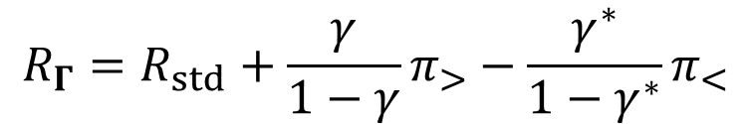
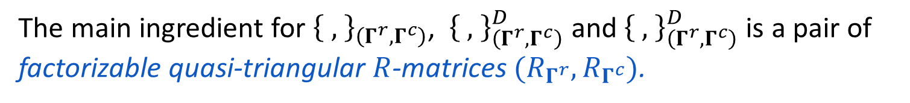
Sidenote: The $R$-matrix
The main ingredient for ${\left\{ , \right\}}_{\left(Γ^{r}, Γ^{c}\right)}$, ${\left\{ , \right\}}_{\left(Γ^{r},Γ^{c}\right)}^{D}$ and ${\left\{ , \right\}}_{\left(Γ^{r},Γ^{c}\right)}^{D}$ is a pair of factorizable quasi-triangular $R$-matrices $(R_{Γ^{r}},R_{Γ^{c}})$.
(they satisfy the Classical Yang-Baxter equation and depend on the BD quadruples)
For a trivial BD quadruple $(∅,∅,∅,R_{0})$, $R≔R_{std}$ is given by
$$R_{std}=π_{>}+R_{0}π_{0}$$
projection onto $𝔥$
projection onto $𝔫_{+}$
For a nontrivial BD quadruple $(Γ_{1},Γ_{2},γ,R_{0})$, $R≔R_{Γ}$ is given by
$$R_{Γ}=R_{std}+\frac{γ}{1−γ}π_{>}−\frac{γ^{∗}}{1−γ^{∗}}π_{<}$$
Denote ${\left\{ , \right\}}_{std}$ , ${\left\{ , \right\}}_{std}^{D}$ and ${\left\{ , \right\}}_{std}^{D}$ for $(Γ_{std},Γ_{std})$, $Γ_{std}≔(∅,∅,∅)$.
(in a sense, a nontrivial BD data deforms a standard Poisson bracket; we get extra terms)

Slide 17


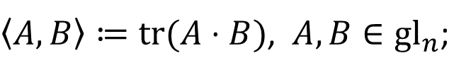

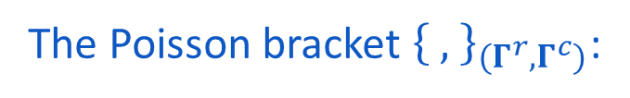
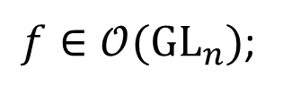
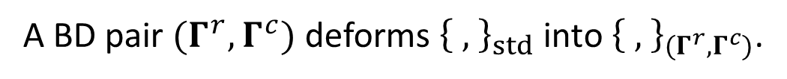
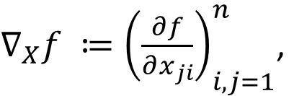
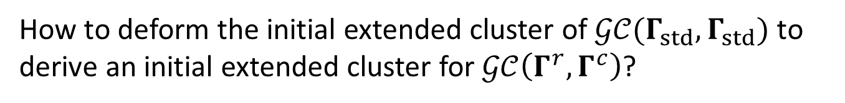
Case of $(GL_{n},{\left\{ , \right\}}_{\left(Γ^{r},Γ^{c}\right)})$ and $𝒢𝒞(Γ^{r},Γ^{c})$
Define
$∇_{X}f ≔{\left(\frac{∂f}{∂x_{ji}}\right)}_{i,j=1}^{n}$,
$\left\langle A,B\right\rangle ≔tr(A⋅B)$, $A,B∈gl_{n}$;
$f∈𝒪(GL_{n})$;
The Poisson bracket ${\left\{ , \right\}}_{(Γ^{r},Γ^{c})}$:
${\left\{f,g\right\}}_{(Γ^{r},Γ^{c})}\left(X\right)≔\left\langle R_{Γ^{c}}\left(∇_{X}f⋅X\right),∇_{X}g⋅X\right\rangle −⟨R_{Γ^{r}}\left(X∇_{X}f\right),X∇_{X}g⟩$,
$$X∈GL_{n}.$$
Question
A BD pair $(Γ^{r},Γ^{c})$ deforms ${\left\{ , \right\}}_{std}$ into ${\left\{ , \right\}}_{(Γ^{r},Γ^{c})}$.
How to deform the initial extended cluster of $𝒢𝒞(Γ_{std},Γ_{std})$ to derive an initial extended cluster for $𝒢𝒞\left(Γ^{r},Γ^{c}\right)$?
Answer
Construct a Poisson birational map $𝒰:\left(G,{\left\{ , \right\}}_{std}\right)⇢(G,{\left\{ , \right\}}_{\left(Γ^{r},Γ^{c}\right)})$.
Then apply ${\left(𝒰^{−1}\right)}^{∗}$ to the initial extended cluster of $𝒢𝒞(Γ_{std},Γ_{std})$.
(the same idea for $𝒢𝒞^{D}(Γ^{r},Γ^{c})$ and $𝒢𝒞^{\text{†}}(Γ^{c})$)

Slide 18
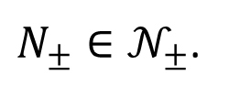


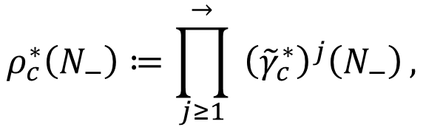
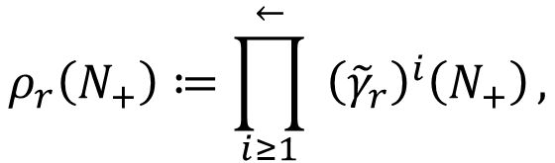
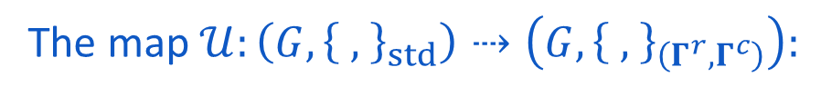
The map $𝒰$ for $(GL_{n},{\left\{ , \right\}}_{\left(Γ^{r},Γ^{c}\right)})$
Gauss decomposition:
For a generic $X∈GL_{n}$, write $X=X_{+}X_{0}X_{−}$ where $X_{±}∈𝒩_{±}$ and $X_{0}∈ℋ$.
Define the maps $ρ_{r}:𝒩_{+}→𝒩_{+}$ and $ρ_{c}^{∗}:𝒩_{−}→𝒩_{−}$:
$$ρ_{r}\left(N_{+}\right)≔\prod_{i≥1}^{←}{ {\left({\tilde{γ}}_{r}\right)}^{i}\left(N_{+}\right)},$$
$$ρ_{c}^{∗}\left(N_{−}\right)≔\prod_{j≥1}^{→}{ {\left({\tilde{γ}}_{c}^{∗}\right)}^{j}\left(N_{−}\right)},$$
$N_{±}∈𝒩_{±}$.
The map $𝒰:\left(G,{\left\{ , \right\}}_{std}\right)⇢\left(G,{\left\{ , \right\}}_{\left(Γ^{r},Γ^{c}\right)}\right):$
$$𝒰\left(X\right)≔ρ_{r}\left({\left[XW_{0}\right]}_{+}\right)⋅X⋅ρ_{c}^{∗}({\left[W_{0}X\right]}_{−})$$
Theorem.
1) If $(R_{0}^{r},R_{0}^{c})$ are the same for both ${\left\{ , \right\}}_{\left(Γ^{r},Γ^{c}\right)}$ and ${\left\{ , \right\}}_{std}$, the map is Poisson;
2) $𝒰^{−1}$ is rational if and only if $(Γ^{r},Γ^{c})$ is aperiodic.
(that is, $γ_{r}w_{0}γ_{c}^{∗}w_{0}^{−1}$ is nilpotent)
(Gekhtman-Shapiro-Vainshtein described $𝒰$ via Berenstein-Fomin-Zelevinsky parameters in their paper (2023); I found later that there is a closed formula)

Slide 19

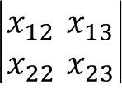





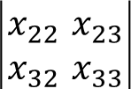







An explicit example in $GL_{3}$
$$1$$
$$2$$
$$x_{12}$$ | $$x_{13}$$
$$x_{22}$$ | $$x_{23}$$
Set $Γ≔Γ^{r}≔Γ^{c}≔\left(\{1\right\},\left\{2\right\},1↦2)$.
$$\det{X}$$
$$x_{13}$$
$$1$$
$$2$$
Then $𝒰$ is given by
$$x_{21}$$ | $$x_{22}$$
$$x_{31}$$ | $$x_{32}$$
$$x_{23}$$
$𝒰\left(X\right)=\left[I+\frac{\det\left|\begin{matrix}x_{11} & x_{12} \\ x_{31} & x_{32}\end{matrix}\right|}{\det\left|\begin{matrix}x_{21} & x_{22} \\ x_{31} & x_{32}\end{matrix}\right|}e_{23}\right]⋅X⋅\left[I+\frac{x_{12}}{x_{13}}e_{21}\right]$
$$x_{22}$$ | $$x_{23}$$
$$x_{32}$$ | $$x_{33}$$
$$x_{31}$$
$$x_{32}$$
$$x_{33}$$
$$𝒢𝒞(Γ_{std},Γ_{std})$$
Frozen in $𝒢𝒞(Γ_{std},Γ_{std})$
Nuance. An application of ${\left(𝒰^{−1}\right)}^{∗}$ yields rational functions.
However, cluster and frozen variables have to be regular functions.
Thus we extract only the numerators. But how does that affect the quiver?

Slide 20











Changes in the quiver
$$x_{12}$$ | $$x_{13}$$
$$x_{22}$$ | $$x_{23}$$
$$\det{X}$$
$${\left(𝒰^{−1}\right)}^{∗}$$
$$x_{13}$$
$$x_{13}$$
$$x_{21}$$ | $$x_{22}$$
$$x_{31}$$ | $$x_{32}$$
$$x_{21}$$ | $$x_{22}$$
$$x_{31}$$ | $$x_{32}$$
$$x_{23}$$
$$x_{22}$$ | $$x_{23}$$
$$x_{32}$$ | $$x_{33}$$
$$x_{22}$$ | $$x_{23}$$
$$x_{32}$$ | $$x_{33}$$
$$x_{31}$$ | $$x_{32}$$
$$x_{12}$$ | $$x_{13}$$
$$x_{31}$$
$$x_{32}$$
$$x_{33}$$
$$x_{32}$$
$$x_{33}$$
$$𝒢𝒞(Γ_{std},Γ_{std})$$
$$x_{13}$$
A mutation relation for $x_{32}$ on the left:
$$x_{32}⋅\det\left[\begin{matrix}x_{21} & x_{23} \\ x_{31} & x_{33}\end{matrix}\right]=\det\left[\begin{matrix}x_{22} & x_{23} \\ x_{32} & x_{33}\end{matrix}\right]x_{31}+\det\left[\begin{matrix}x_{21} & x_{22} \\ x_{31} & x_{32}\end{matrix}\right]x_{33}$$

Slide 21

Changes in the quiver
$$x_{12}$$ | $$x_{13}$$
$$x_{22}$$ | $$x_{23}$$
$$\det{X}$$
$${\left(𝒰^{−1}\right)}^{∗}$$
$$x_{13}$$
$$x_{13}$$
$$x_{21}$$ | $$x_{22}$$
$$x_{31}$$ | $$x_{32}$$
$$x_{21}$$ | $$x_{22}$$
$$x_{31}$$ | $$x_{32}$$
$$x_{23}$$
$$x_{22}$$ | $$x_{23}$$
$$x_{32}$$ | $$x_{33}$$
$$x_{22}$$ | $$x_{23}$$
$$x_{32}$$ | $$x_{33}$$
$$x_{31}$$ | $$x_{32}$$
$$x_{12}$$ | $$x_{13}$$
$$x_{31}$$
$$x_{32}$$
$$x_{33}$$
$$x_{32}$$
$$x_{33}$$
$$𝒢𝒞(Γ_{std},Γ_{std})$$
$$x_{13}$$
An application of ${\left(𝒰^{−1}\right)}^{∗}$ to the mutation relation yields:
$$x_{32}⋅\frac{\det\left[\begin{matrix}x_{13} & x_{12} & 0 \\ x_{22} & x_{21} & x_{23} \\ x_{32} & x_{31} & x_{33}\end{matrix}\right]}{x_{13}}=\det\left[\begin{matrix}x_{22} & x_{23} \\ x_{32} & x_{33}\end{matrix}\right]\frac{\det\left[\begin{matrix}x_{31} & x_{32} \\ x_{12} & x_{13}\end{matrix}\right]}{x_{13}}+\det\left[\begin{matrix}x_{21} & x_{22} \\ x_{31} & x_{32}\end{matrix}\right]x_{33}$$

Slide 22






Changes in the quiver
$$x_{12}$$ | $$x_{13}$$
$$x_{22}$$ | $$x_{23}$$
$$\det{X}$$
$${\left(𝒰^{−1}\right)}^{∗}$$
$$x_{13}$$
$$x_{13}$$
$$x_{21}$$ | $$x_{22}$$
$$x_{31}$$ | $$x_{32}$$
$$x_{21}$$ | $$x_{22}$$
$$x_{31}$$ | $$x_{32}$$
$$x_{23}$$
$$x_{22}$$ | $$x_{23}$$
$$x_{32}$$ | $$x_{33}$$
$$x_{22}$$ | $$x_{23}$$
$$x_{32}$$ | $$x_{33}$$
$$x_{31}$$ | $$x_{32}$$
$$x_{12}$$ | $$x_{13}$$
$$x_{31}$$
$$x_{32}$$
$$x_{33}$$
$$x_{32}$$
$$x_{33}$$
$$𝒢𝒞(Γ_{std},Γ_{std})$$
$$x_{13}$$
Once we multiply by $x_{13}$, we get a mutation relation for $x_{32}$ on the right. Hence an arrow!
$$x_{32}⋅\det\left[\begin{matrix}x_{13} & x_{12} & 0 \\ x_{22} & x_{21} & x_{23} \\ x_{32} & x_{31} & x_{33}\end{matrix}\right]=\det\left[\begin{matrix}x_{22} & x_{23} \\ x_{32} & x_{33}\end{matrix}\right]\det\left[\begin{matrix}x_{31} & x_{32} \\ x_{12} & x_{13}\end{matrix}\right]+\det\left[\begin{matrix}x_{21} & x_{22} \\ x_{31} & x_{32}\end{matrix}\right]x_{33}x_{13}$$

Slide 23











Final quiver for $(GL_{3},{\left\{ , \right\}}_{(Γ,Γ)})$
$$x_{12}$$ | $$x_{13}$$
$$x_{22}$$ | $$x_{23}$$ | $$x_{11}$$ | $$x_{12}$$
$$x_{32}$$ | $$x_{33}$$ | $$x_{21}$$ | $$x_{22}$$
 |  | $$x_{31}$$ | $$x_{32}$$
$$x_{12}$$ | $$x_{13}$$
$$x_{22}$$ | $$x_{23}$$
$$\det{X}$$
$$x_{13}$$
$$\det{X}$$
$$x_{13}$$
$$x_{21}$$ | $$x_{22}$$
$$x_{31}$$ | $$x_{32}$$
$$x_{21}$$ | $$x_{22}$$
$$x_{31}$$ | $$x_{32}$$
$$x_{23}$$ | $$x_{11}$$ | $$x_{12}$$
$$x_{33}$$ | $$x_{21}$$ | $$x_{22}$$
 | $$x_{31}$$ | $$x_{32}$$
$$x_{23}$$
$$x_{22}$$ | $$x_{23}$$
$$x_{32}$$ | $$x_{33}$$
$$x_{31}$$ | $$x_{32}$$
$$x_{12}$$ | $$x_{13}$$
$$x_{22}$$ | $$x_{23}$$
$$x_{32}$$ | $$x_{33}$$
$$x_{31}$$
$$x_{32}$$
$$x_{33}$$
$$x_{32}$$
$$x_{33}$$
$$𝒢𝒞(Γ_{std},Γ_{std})$$
$𝒢𝒞(Γ,Γ)$ with $Γ=\left(\{1\right\},\left\{2\right\},1↦2)$
Note: we get fewer frozen variables on the right.
The variables $x_{13}$ and $\det\left[\begin{matrix}x_{21} & x_{22} \\ x_{31} & x_{32}\end{matrix}\right]$ are marked: they are frozen on the left but not frozen on the right. And it is precisely those variables that appear in the denominators of $𝒰$. It is always the case.

Slide 24










Final feature: $𝒰$ is a quasi-isomorphism
Mutate both seeds at $x_{32}$, for instance:
$$x_{12}$$ | $$x_{13}$$
$$x_{22}$$ | $$x_{23}$$ | $$x_{11}$$ | $$x_{12}$$
$$x_{32}$$ | $$x_{33}$$ | $$x_{21}$$ | $$x_{22}$$
 |  | $$x_{31}$$ | $$x_{32}$$
$$x_{12}$$ | $$x_{13}$$
$$x_{22}$$ | $$x_{23}$$
$$\det{X}$$
$$x_{13}$$
$$\det{X}$$
$$x_{13}$$
$$x_{21}$$ | $$x_{22}$$
$$x_{31}$$ | $$x_{32}$$
$$x_{21}$$ | $$x_{22}$$
$$x_{31}$$ | $$x_{32}$$
$$x_{23}$$ | $$x_{11}$$ | $$x_{12}$$
$$x_{33}$$ | $$x_{21}$$ | $$x_{22}$$
 | $$x_{31}$$ | $$x_{32}$$
$$x_{23}$$
$$x_{22}$$ | $$x_{23}$$
$$x_{32}$$ | $$x_{33}$$
$$x_{31}$$ | $$x_{32}$$
$$x_{12}$$ | $$x_{13}$$
$$x_{22}$$ | $$x_{23}$$
$$x_{32}$$ | $$x_{33}$$
$$x_{31}$$
$$x_{21}$$ | $$x_{23}$$
$$x_{31}$$ | $$x_{33}$$
$$x_{33}$$
$$x_{33}$$
Mutation of $x_{32}$ on the left
$$x_{13}$$ | $$x_{12}$$
$$x_{22}$$ | $$x_{21}$$ | $$x_{23}$$
$$x_{32}$$ | $$x_{31}$$ | $$x_{33}$$
$$𝒰^{∗}\left(\det\left[\begin{matrix}x_{13} & x_{12} & 0 \\ x_{22} & x_{21} & x_{23} \\ x_{32} & x_{31} & x_{33}\end{matrix}\right]\right)=\det\left[\begin{matrix}x_{21} & x_{23} \\ x_{31} & x_{33}\end{matrix}\right]x_{13}$$
In general, a monomial in the marked variables
Mutation of $x_{32}$ on the right

Slide 25




Part 4. Description of $𝒢𝒞^{\text{†}}(Γ)$ in type $A$
The contrast between ${\left\{ , \right\}}_{(Γ^{r},Γ^{c})}$ and ${\left\{ , \right\}}_{Γ^{c}}^{\text{†}}$:
The trace form
$${\left\{f,g\right\}}_{(Γ^{r},Γ^{c})}\left(U\right)=\left\langle R_{Γ^{c}}\left(∇_{U}f⋅U\right),∇_{U}g⋅U\right\rangle −\left\langle R_{Γ^{r}}\left(U∇_{U}f\right),U∇_{U}g\right\rangle ,$$
$$U∈GL_{n};$$
Matrix of partial derivatives of $f$
$${\left\{f, g\right\}}_{Γ^{c}}^{\text{†}}\left(U\right)=\left\langle R_{Γ^{c}}\left(\left[∇_{U}f,U\right]\right),\left[∇_{U}g,U\right]\right\rangle −\left\langle \left[∇_{U}f,U\right],∇_{U}gU\right\rangle .$$
(at least one can say that conjugation plays a certain role in $𝒢𝒞^{\text{†}}(Γ)$ )

Slide 26




Recall $𝒢𝒞(Γ_{std}^{r},Γ_{std}^{c})$ for $(GL_{n},{\left\{ , \right\}}_{std})$
The initial extended cluster consists of two sets of flag minors.
Flag minors with last columns:
$u_{14}$, $\det\left[\begin{matrix}u_{23} & u_{24} \\ u_{33} & u_{34}\end{matrix}\right]$, etc.
Flag minors with last rows:
$u_{42}$, $\det\left[\begin{matrix}u_{31} & u_{32} \\ u_{41} & u_{42}\end{matrix}\right]$, etc.
$$U=\left[ \begin{matrix}u_{11} & u_{12} & u_{13} & u_{14} \\ u_{21} & u_{22} & u_{23} & u_{24} \\ u_{31} & u_{32} & u_{33} & u_{34} \\ u_{41} & u_{42} & u_{43} & u_{44}\end{matrix}\right]∈GL_{4}$$

Slide 27



















The initial extended cluster for $𝒢𝒞^{\text{†}}(Γ_{std})$ in type $A$
Select only one set of flag minors.
$φ$-functions
$φ$-functions
(hence, two versions of $𝒢𝒞^{\text{†}}\left(Γ\right)$)
$$h$$
$$U↦U^{T}$$
$$g$$
$$c_{i}\left(U\right):=χ_{Λ^{i}ℝ^{n}}(U)$$
$g$-functions
$$c$$
(characters; also, Casimirs of ${\left\{ , \right\}}_{Γ^{c}}^{\text{†}}$)
$h$-functions
$$U↦W_{0}^{−1}UW_{0}$$
$$φ$$
$$φ$$
$c$-functions
$c$-functions
$$𝒢𝒞_{h}^{\text{†}}(Γ_{std})$$
$$𝒢𝒞_{g}^{\text{†}}(Γ_{std})$$
a vertex with a generalized mutation
$$φ_{11}\left(U\right)=\det{[\begin{matrix}e_{n} & Ue_{n} & ⋯ & U^{n−1}e_{n}]\end{matrix}}$$
$$φ_{11}\left(U\right)=\det{[\begin{matrix}e_{1} & Ue_{1} & ⋯ & U^{n−1}e_{1}]\end{matrix}}$$
(related to the highest weight theory)
$$𝒢𝒞(Γ_{std},Γ_{std})$$

Slide 28





A closer look at the generalized mutation
$$φ_{11}$$
$$c_{n}\left(U\right)≔det{U}$$
$$φ_{21}$$
$$φ_{12}$$
An arbitrary number of terms in the RHS is allowed
$$φ_{11}φ_{11}^{′}=\sum_{r=0}^{n}{c_{r}φ_{21}^{r}}φ_{12}^{n−r}$$
Coefficients are allowed, but only Casimirs.
(in this case, $\left\{c_{i} \right| i∈[1,n−1]\}$ serve both as coefficients and isolated frozen variables; the variable $c_{n}$ is frozen but not isolated; $c_{0}=1$)

Slide 29









Poisson birational quasi-isomorphisms for the dagger
Setup. $G$ is a reductive complex Lie group, $Γ≔\left(Γ_{1},Γ_{2},γ\right)$ any BD triple.
Gauss decomposition:
For a generic $U∈G$, write $U=U_{+}U_{0}U_{−}$ where $U_{±}∈𝒩_{±}$ and $U_{0}∈ℋ$.
Recall the map $ρ^{∗}:𝒩_{−}→𝒩_{−}$:
$$ρ^{∗}\left(N_{−}\right)≔\prod_{j≥1}^{→}{ {\left({\tilde{γ}}^{∗}\right)}^{j}\left(N_{−}\right)},$$
$N_{±}∈𝒩_{±}$.
The map $𝒬_{h}:(G,{\left\{ ,\right\}}_{std}^{\text{†}})⇢(G,{\left\{ , \right\}}_{Γ}^{\text{†}})$ ($h$-convention):
(it’s similar for the $g$-convention, see the end of the slides or the paper)
$𝒬_{h}\left(U\right)≔ρ^{∗}{\left(U_{−}\right)}^{−1}Uρ^{∗}(U_{−})$,
$$U∈G.$$
The rational inverse of $𝒬_{h}$:
$$𝒬_{h}^{−1}(U)≔ ℱ_{h}\left(U\right)⋅{\tilde{γ}}^{∗}{\left({\left[ℱ_{h}\left(U\right)\right]}_{−}\right)}^{−1}$$
where the birational map $ℱ_{h}:G⇢G$ satisfies the equation
(the equation can be solved via a recursive procedure)
$$ℱ_{h}\left(U\right)={\tilde{γ}}^{∗}\left({\left[ℱ_{h}\left(U\right)\right]}_{−}\right)U$$

Slide 30
Poisson birational quasi-isomorphisms for the dagger
Setup. $G$ is a reductive complex Lie group, $Γ≔\left(Γ_{1},Γ_{2},γ\right)$ any BD triple.
Gauss decomposition:
For a generic $U∈G$, write $U=U_{+}U_{0}U_{−}$ where $U_{±}∈𝒩_{±}$ and $U_{0}∈ℋ$.
Recall the map $ρ^{∗}:𝒩_{−}→𝒩_{−}$:
$$ρ^{∗}\left(N_{−}\right)≔\prod_{j≥1}^{→}{ {\left({\tilde{γ}}^{∗}\right)}^{j}\left(N_{−}\right)},$$
$N_{±}∈𝒩_{±}$.
The map $𝒬_{h}:(G,{\left\{ ,\right\}}_{std}^{\text{†}})⇢(G,{\left\{ , \right\}}_{Γ}^{\text{†}})$ ($h$-convention):
(it’s similar for the $g$-convention, see the end of the slides or the paper)
$𝒬_{h}\left(U\right)≔ρ^{∗}{\left(U_{−}\right)}^{−1}Uρ^{∗}(U_{−})$,
$$U∈G.$$
Theorem
1) If the $R_{0}$ parts of ${\left\{ ,\right\}}_{std}^{\text{†}}$ and ${\left\{ , \right\}}_{Γ}^{\text{†}}$ are the same, then $𝒬_{h}$ is Poisson;
2) If $G∈\left\{SL_{n}, GL_{n}\right\}$, then $𝒬_{h}$ is a quasi-isomorphism between $𝒢𝒞^{\text{†}}(Γ_{std})$ and $𝒢𝒞^{\text{†}}(Γ)$.
(D. Voloshyn, M. Gekhtman, 2023)

Slide 31















Part 5. Features of $𝒢𝒞^{\text{D}}(Γ^{r},Γ^{c})$ in type $A$
Relation between the three Poisson varieties:
$$𝒢𝒞(Γ_{std},Γ_{std})$$
$\left(GL_{n},{\left\{ , \right\}}_{\left(Γ^{r},Γ^{c}\right)}\right)∋X↦\left(X,X\right)∈\left(D(GL_{n}),{\left\{ , \right\}}_{\left(Γ^{r},Γ^{c}\right)}^{D}\right)$;
$$GL_{3}$$
$\left(D(GL_{n}),{\left\{ , \right\}}_{\left(Γ^{r},Γ^{c}\right)}^{D}\right)∋\left(X,Y\right)↦U≔X^{−1}Y∈(GL_{n},{\left\{ , \right\}}_{Γ^{c}}^{\text{†}})$.
$D\left(GL_{n}\right)≔GL_{n}×GL_{n}$ (as a Lie group)
$$𝒢𝒞_{h}^{\text{†}}(Γ_{std},GL_{3})$$
The $φ$-functions that depend on $U$
$$𝒢𝒞^{\text{D}}(Γ_{std},Γ_{std})$$
$$D(GL_{3})$$
Flag minors of $X$
The $c$-functions (they depend on $U$)
Stay the same for all $(Γ^{r},Γ^{c})$
Minors of both $X$ and $Y$
Flag minors of $Y$
Depend on$(Γ^{r},Γ^{c})$
Coordinates $\left(X,Y\right)∈D(GL_{n})$

Slide 32














How to see $𝒢𝒞$ inside $𝒢𝒞^{D}$
Relation between the three Poisson varieties:
$$𝒢𝒞(Γ_{std},Γ_{std})$$
$\left(GL_{n},{\left\{ , \right\}}_{\left(Γ^{r},Γ^{c}\right)}\right)∋X↦\left(X,X\right)∈\left(D(GL_{n}),{\left\{ , \right\}}_{\left(Γ^{r},Γ^{c}\right)}^{D}\right)$;
$$GL_{3}$$
$\left(D(GL_{n}),{\left\{ , \right\}}_{\left(Γ^{r},Γ^{c}\right)}^{D}\right)∋\left(X,Y\right)↦U≔X^{−1}Y∈(GL_{n},{\left\{ , \right\}}_{Γ^{c}}^{\text{†}})$.
$D\left(GL_{n}\right)≔GL_{n}×GL_{n}$ (as a Lie group)
$$𝒢𝒞_{h}^{\text{†}}(Γ_{std},GL_{3})$$
The $φ$-functions that depend on $U$
$$𝒢𝒞^{\text{D}}(Γ_{std},Γ_{std})$$
$$D(GL_{3})$$
Flag minors of $X$
The $c$-functions (they depend on $U$)
Set $X=Y$ and merge the triangles on the sides.
Minors of both $X$ and $Y$
Flag minors of $Y$
Coordinates $\left(X,Y\right)∈D(GL_{n})$

Slide 33









How to see $𝒢𝒞_{h}^{\text{†}}$ inside $𝒢𝒞^{D}$
(confirmed only for $n∈\{3,4\}$ and all $(Γ^{r},Γ^{c})$)
Relation between the three Poisson varieties:
$$𝒢𝒞(Γ_{std},Γ_{std})$$
$\left(GL_{n},{\left\{ , \right\}}_{\left(Γ^{r},Γ^{c}\right)}\right)∋X↦\left(X,X\right)∈\left(D(GL_{n}),{\left\{ , \right\}}_{\left(Γ^{r},Γ^{c}\right)}^{D}\right)$;
$$GL_{3}$$
$\left(D(GL_{n}),{\left\{ , \right\}}_{\left(Γ^{r},Γ^{c}\right)}^{D}\right)∋\left(X,Y\right)↦U≔X^{−1}Y∈(GL_{n},{\left\{ , \right\}}_{Γ^{c}}^{\text{†}})$.
$D\left(GL_{n}\right)≔GL_{n}×GL_{n}$ (as a Lie group)
$$𝒢𝒞_{h}^{\text{†}}(Γ_{std},GL_{3})$$
$$𝒢𝒞^{\text{D}}(Γ_{std},Γ_{std})$$
$$D(GL_{3})$$
There is a mutation sequence from the initial extended seed of $𝒢𝒞^{D}$ that yields the initial extended seed of $𝒢𝒞_{h}^{\text{†}}$.

Slide 34




Status of the GSV program
Setup. $G$ is a connected simply connected simple complex Lie group.
(nothing is known for non-simply connected groups)
Trivial BD data:
Case of $𝒢𝒞$ | $$𝒢𝒞(Γ_{std},Γ_{std})$$ | $$𝒢𝒞^{D}(Γ_{std},Γ_{std})$$ | $$𝒢𝒞^{\text{†}}(Γ_{std})$$
What we know | All Lie types | Only type $A$ | Only type $A$
Problem: what to replace the $φ$-functions with?
Nontrivial BD data:
Case of $𝒢𝒞$ | $$𝒢𝒞(Γ^{r},Γ^{c})$$ | $$𝒢𝒞^{D}(Γ^{r},Γ^{c})$$ | $$𝒢𝒞^{\text{†}}(Γ^{c})$$
What we know | All Lie types, aperiodic $(Γ^{r},Γ^{c})$ | Only type $A$, aperiodic $(Γ^{r},Γ^{c})$ | Only type $A$, all $Γ^{c}$
(for $𝒢𝒞(Γ^{r},Γ^{c})$, only type $A$ is published)
Problem: $𝒰^{−1}$ is not rational when $(Γ^{r},Γ^{c})$ is not aperiodic.

Slide 35
Thank you!

Slide 36







List of all Poisson quasi-isomorphisms for the GSV program
(any topology of $G$, any Lie type, any BD pair $(Γ^{r},Γ^{c})$ )
Gauss decomposition:
For a generic $X∈GL_{n}$, write $X=X_{+}X_{0}X_{−}$ where $X_{±}∈𝒩_{±}$ and $X_{0}∈ℋ$.
Recall the maps $ρ_{r}:𝒩_{+}→𝒩_{+}$ and $ρ_{c}^{∗}:𝒩_{−}→𝒩_{−}$:
$$ρ_{r}\left(N_{+}\right)≔\prod_{i≥1}^{←}{ {\left({\tilde{γ}}_{r}\right)}^{i}\left(N_{+}\right)},$$
$$ρ_{c}^{∗}\left(N_{−}\right)≔\prod_{j≥1}^{→}{ {\left({\tilde{γ}}_{c}^{∗}\right)}^{j}\left(N_{−}\right)},$$
$N_{±}∈𝒩_{±}$.
The map $𝒰^{D}:\left(D\left(G\right),{\left\{ , \right\}}_{std}^{D}\right)⇢(D\left(G\right), {\left\{ , \right\}}_{\left(Γ^{r},Γ^{c}\right)}^{D})$ for the Drinfeld double:
$$𝒰^{D}\left(X,Y\right)≔\left(ρ_{r}\left({\left[W_{0}X\right]}_{+}\right)Xρ_{c}^{∗}\left({\left[YW_{0}\right]}_{−}\right),ρ_{r}\left({\left[W_{0}X\right]}_{+}\right)Yρ_{c}^{∗}\left({\left[YW_{0}\right]}_{−}\right)\right),$$
$(X,Y)∈D(G)$.
The map $𝒰:\left(G,{\left\{ , \right\}}_{std}\right)⇢(G,{\left\{ , \right\}}_{\left(Γ^{r},Γ^{c}\right)})$:
$𝒰\left(X\right)≔𝒰^{D}(X,X)$.
The maps $𝒬_{h},𝒬_{g}:(G,{\left\{ ,\right\}}_{std}^{\text{†}})⇢(G,{\left\{ , \right\}}_{Γ}^{\text{†}})$ for the dagger:
$𝒬_{h}\left(U\right)≔ρ^{∗}{\left(U_{−}\right)}^{−1}Uρ^{∗}(U_{−})$,
$𝒬_{g}(U_{+})≔ρ\left(U_{+}\right)Uρ{\left(U_{+}\right)}^{−1}$,
$$U∈G.$$
Notes:
We usually denote an element of $G$ by $U$ in the case of dagger instead of $X$, because of the relation with the double, where $U=X^{−1}Y$ (see a Poisson map that relates the double with the dagger).

Slide 37

Latest references on the program
D. Voloshyn, M. Gekhtman, ‘Generalized cluster structures on $SL_{n}^{\text{†}}$’, Preprint, 2023. arXiv:2312.04859.
This is the latest paper on the subject with up-to-date techniques. There we constructed the Poisson birational maps $𝒬_{h}$ and $𝒬_{g}$ along with many others, and we constructed $𝒢𝒞^{\text{†}}(Γ)$ for all BD triples $Γ$ on $SL_{n}$. However, we don’t know how to construct $𝒢𝒞^{\text{†}}(Γ_{std})$ for other Lie types. Once we know that, by means of $𝒬_{h}$ or $𝒬_{g}$ we will be able to construct $𝒢𝒞^{\text{†}}(Γ)$ for all BD triples $Γ$.
D. Voloshyn, ‘Starfish lemma via birational quasi-isomorphisms’, Preprint, 2023. arXiv:2311.00404.
This paper contains techniques for proving that the upper cluster algebra equals the coordinate ring, as well as for proving irreducibility and coprimality of variables.
D. Voloshyn, github repository: github.com/Grabovskii/Dagger_examples
Here, one can find supplementary information on $𝒢𝒞^{\text{†}}(Γ)$, as well as explicitly computed examples.

Slide 38


M. Gekhtman, M. Shapiro and A. Vainshtein, ’A unified approach to exotic cluster structures on simple Lie groups’, Preprint, 2023. arXiv:2308.16701.
The paper offers a construction of a Poisson quasi-isomorphism $h:\left(G,{\left\{ , \right\}}_{std}\right)⇢(G,{\left\{ , \right\}}_{\left(Γ^{r},Γ^{c}\right)})$. However, by now we know a simple explicit formula (see the slides), and $𝒰=h$. The paper also contains a combinatorial description of the initial extended seed for $SL_{n}$ when the BD pair is aperiodic but not necessarily oriented.
D. Voloshyn, ’Multiple generalized cluster structures on $D(GL_{n})$’, Forum of Mathematics, Sigma (11)(46) (2023), 1–78. doi:10.1017/fms.2023.44
By now, we know that the results of this paper could be obtained in a simpler and more conceptual way, via the Poisson birational quasi-isomorphism $𝒰^{D}$; for the proof of the equality between the upper cluster algebra and the coordinate ring, one can now use the results of the paper ‘Starfish lemma via birational quasi-isomorphisms’.
M. Gekhtman, M. Shapiro and A. Vainshtein, ‘Periodic staircase matrices and generalized cluster structures’, Int. Math. Res. Not. IMRN 2022(6), 4181-4221. arXiv:1912.00453.
This paper studies generalized patterns of cluster mutations, and it presents an ad hoc way of generating such patterns. Then (in type A) the authors use them for constructing generalized cluster structures compatible with non-aperiodic BD pairs. However, it is not clear how it can be generalized to other Lie types, and so far there are no tools for proving that the procedure always works.

Slide 39

M. Gekhtman, M. Shapiro and A. Vainshtein, ‘Drinfeld double of $GL_{n}$ and generalized cluster structures’, Proc. Lond. Math. Soc. 116(3) (2018), 429-484. arXiv:1605.05705.
This is the first paper in which $𝒢𝒞^{D}(Γ_{std},Γ_{std})$ and $𝒢𝒞^{\text{†}}(Γ_{std})$ were constructed (in type $A$). Also, it was shown how $𝒢𝒞\left(Γ_{std},Γ_{std}\right)$, $𝒢𝒞^{D}(Γ_{std},Γ_{std})$ and $𝒢𝒞^{\text{†}}(Γ_{std})$ are related to one another. The paper preserves its actuality, for it contains a proof of $𝒪=\overline{𝒜}$ in the case of the trivial BD triples.
M. Gekhtman, M. Shapiro and A. Vainshtein, ‘Generalized cluster structures related to the Drinfeld double of $GL_{n}$’, J. Lond. Math. Soc. 105(3) (2022), 1601-1633. arXiv:2004.05118.
A companion paper to ‘Periodic staircase matrices and generalized cluster mutations’.

Slide 40

Some older references on the program
M. Gekhtman, M. Shapiro and A. Vainshtein, ’Plethora of cluster structures on $GL_{n}$’, Preprint, 2019. arXiv:1902.02902.
This was the first paper in the GSV program where a birational quasi-isomorphism was used, but in a limited context: only to simplify the proof that the upper cluster algebra the coordinate ring. The methods are already obsolete, but the paper contains a thorough combinatorial description of the initial extended seed on $SL_{n}$ when $(Γ^{r},Γ^{c})$ is aperiodic and oriented.
M. Gekhtman, M. Shapiro and A. Vainshtein, ’Cluster algebras and Poisson geometry’, Mosc. Math. J. 3(3) (2003), 899-934; arXiv:0208033.
The first paper on the connection between cluster algebras and Poisson geometry. In particular, the compatibility equation is formulated in a more general way than in the presentation.
M. Gekhtman, M. Shapiro and A. Vainshtein, ’Cluster structures on simple complex Lie groups and Belavin-Drinfeld classification’, Mosc. Math. J. 12(2) (2010), 293-312; arXiv:1101.0015.
The paper that initiated the research program on constructing cluster structures compatible with Belavin-Drinfeld Poisson brackets in the coordinate rings of simple simply connected complex algebraic groups.

Slide 41
Other references mentioned in slides
S. Fomin and A. Zelevinsky, ’Cluster algebras I: Foundations’, J. Amer. Math. Soc. 15(2) (2002), 497–529. doi:10.1090/S0894-0347-01-00385-X
Classics. The first paper on cluster algebras, where the main definitions were formulated and a research program on cluster algebras was suggested.
B. Nguyen, K. Trampel and M. Yakimov, ’Noncommutative discriminants via Poisson primes’, Adv. Math. 322(2017), 269-307. doi:10.1016/j.aim.2017.10.018
In this paper in Remark 2.4 one can find a geometric interpretation (with a proof) of Poisson prime ideals.

